Slide 1

Crypto Market Analysis using webscraping and EDA
Presented by :
Galapalwar Shivani
Batch No : 536

Slide 2
About me
Background :
I completed my Bachelor of Technology in CSE from Bharat institute of engineering and technology
Why you want to learn Data Science :
I want to learn Data Science to turn data into meaningful insights and build practical solutions using data.
Any work experience :
Fresher
LinkedIn : https://www.linkedin.com/in/galapalwar-shivani-04782640b/
GitHub : https://github.com/shivanigalpalwar

Slide 3
Agenda :
Introduction
Business Problem
Problem Statement
Dataset Overview
Columns Explanation
Tools and Methodology
Univariate analysis
Bivariate analysis
Multivariate analysis
Hypothesis Testing
Conclusion
Recommendations

Slide 4
Introduction
Cryptocurrency has emerged as an important part of the digital financial world, attracting investors and traders worldwide. With thousands of digital currencies available, understanding the crypto market has become increasingly interesting. Platforms like CoinGecko provide valuable information about cryptocurrency prices, market rankings, and trading activity. In this project, Python is used to collect and explore cryptocurrency data through web scraping. The collected data is processed and analyzed using Pandas, Matplotlib, and Seaborn. Different charts and statistical methods help uncover trends and patterns in the market. This project provides practical experience in web scraping, data cleaning, exploratory data analysis, and data-driven decision-making.

Slide 5
Business Problem :
The cryptocurrency market is highly volatile, with prices changing frequently. Investors may find it difficult to understand these changes and identify meaningful market trends. Different cryptocurrencies show different price movements and trading activities. Understanding the relationship between daily and weekly price changes can provide useful insights. Market capitalization and trading volume are important indicators of cryptocurrency performance. However, the relationship between these indicators may not always be clear. This project uses web scraping to collect cryptocurrency market data. Exploratory Data Analysis (EDA) and statistical techniques are applied to identify patterns and relationships. The main objective is to gain meaningful insights into cryptocurrency market behavior through data analysis and visualization.

Slide 6
Problem Statement :
This project addresses the problem of understanding how cryptocurrency prices, market capitalization, and trading volume vary across different cryptocurrencies. It specifically investigates whether daily price changes are significantly related to weekly price changes and whether market capitalization is associated with 24-hour trading volume. The analysis uses cryptocurrency data scraped from CoinGecko. The collected data is cleaned to handle missing values and inconsistent formats. Exploratory Data Analysis (EDA) is performed to compare cryptocurrency performance and identify market patterns. Statistical correlation and hypothesis testing are used to examine relationships between key variables. The goal is to provide clear, data-driven insights into cryptocurrency market behavior through visualizations and statistical analysis.

Slide 7
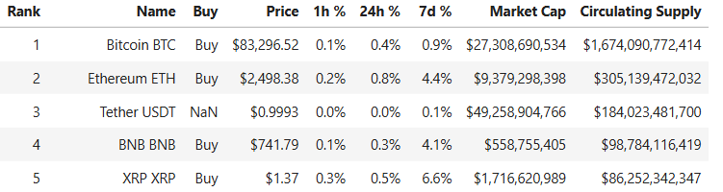
Dataset Overview
Data Source: CoinGecko cryptocurrency platform.
Data Collection: Web scraping using Python.
Total Records: 3000 cryptocurrencies.
Total Columns: 9 columns in the original dataset.
Dataset Format: CSV

Slide 8
Columns Explanation :
Rank: Shows the cryptocurrency's position in the market ranking.
Name: Contains the cryptocurrency name and its ticker symbol, such as Bitcoin (BTC) and Ethereum (ETH).
Buy: Displays a Buy option on the website; some entries may have missing values.
Price: Represents the current price of each cryptocurrency in USD.
1h %: Shows the percentage change in cryptocurrency price over the last hour.
24h %: Indicates the percentage change in price over the last 24 hours.
7d %: Represents the percentage change in price over the last seven days.
Market Cap: Displays the total market value of a cryptocurrency.
Circulating Supply: Shows the number of cryptocurrency coins or tokens currently circulating in the market.

Slide 9
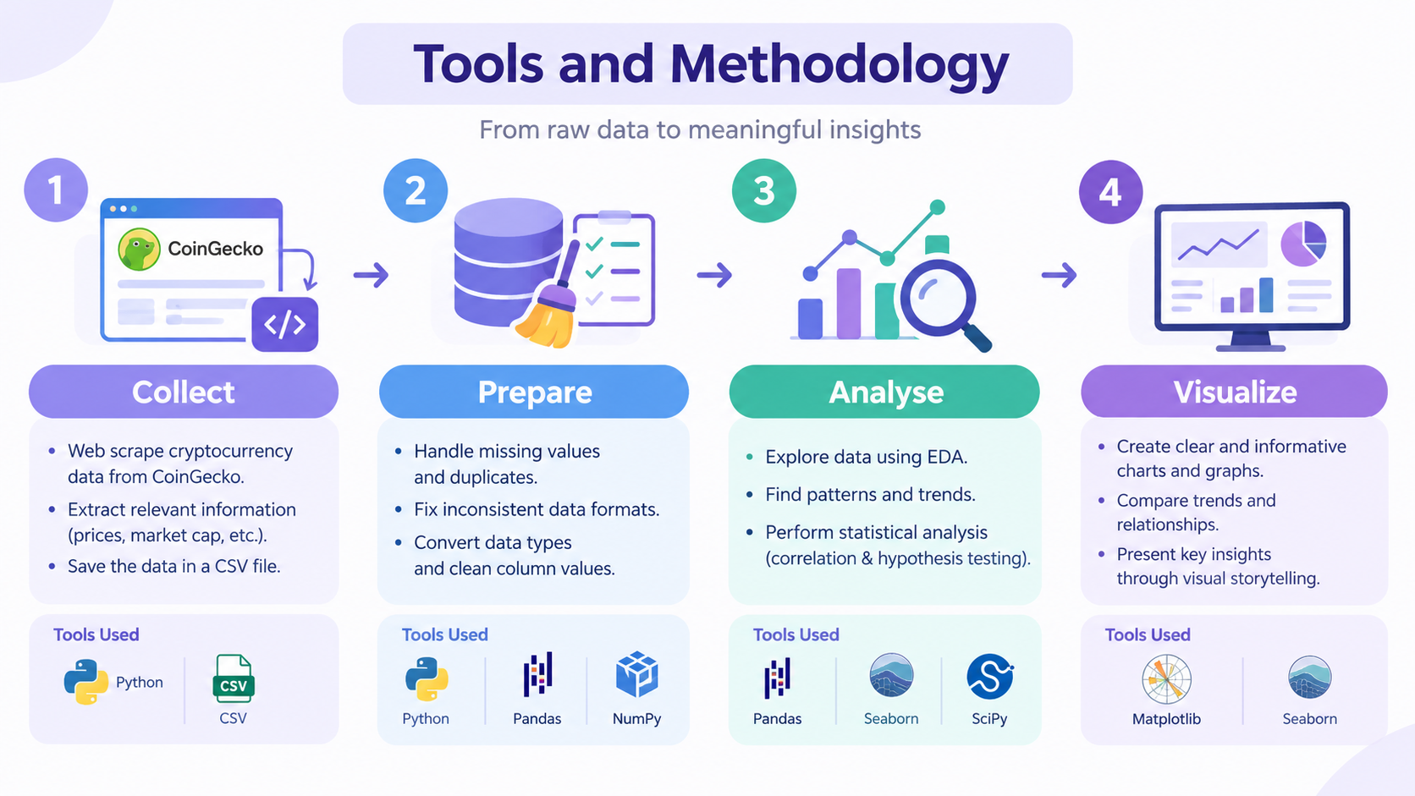

Slide 10
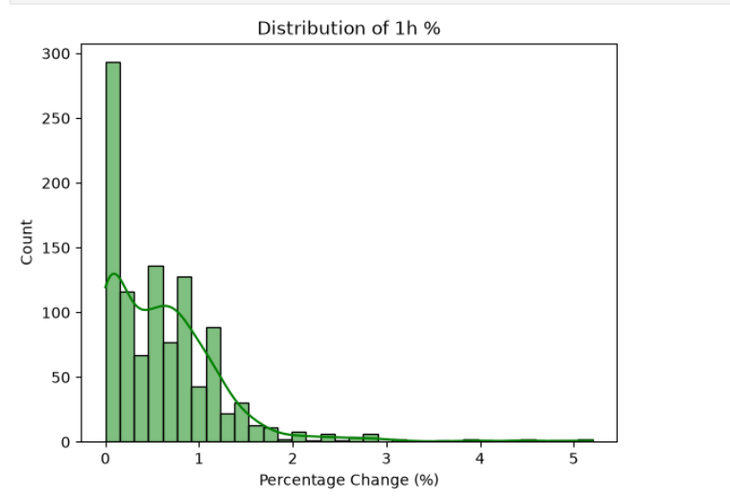
Univariate analysis
1. Distribution of 1h %
Most cryptocurrencies show small positive price changes within one hour. The distribution is right-skewed, with a few cryptocurrencies experiencing larger short-term price increases.

Slide 11
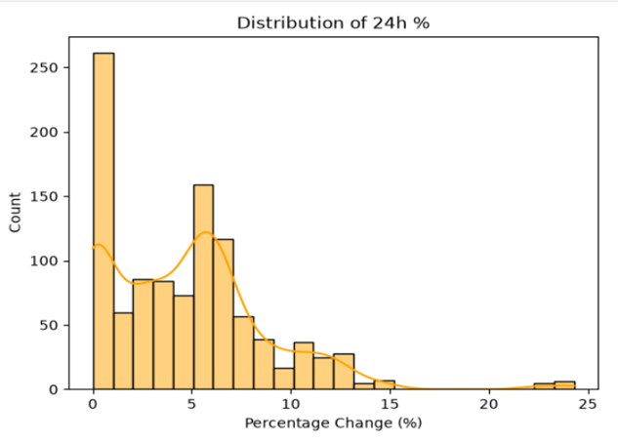
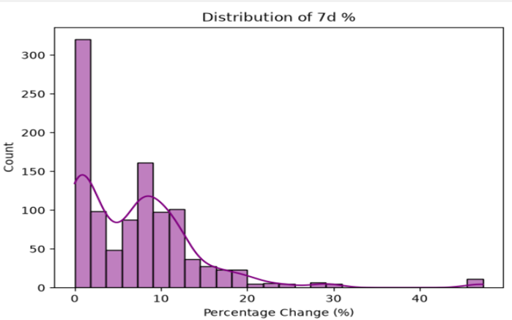
2. Distribution of 24h %
Most cryptocurrencies have daily price changes concentrated at lower percentages, while some show larger increases. A few extreme values extend beyond 20%, indicating unusually high daily price movements.
3. Distribution of 7d %
Most cryptocurrencies show relatively low to moderate weekly price increases, while a few experience very large gains. The right-skewed distribution indicates considerable variation in weekly performance, with some extreme values exceeding 40%.

Slide 12
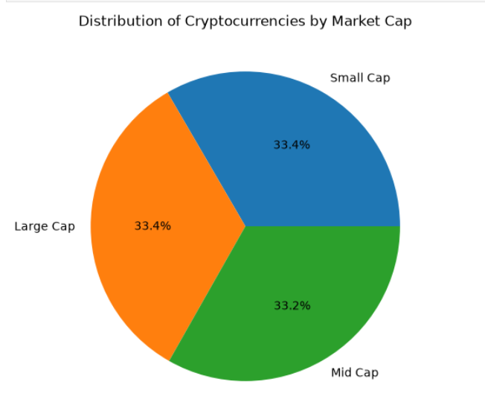
Interpretation
Distribution of Cryptocurrencies by Market Cap
The pie chart shows an almost equal distribution of cryptocurrencies across the three market capitalization categories. Small-cap and large-cap cryptocurrencies each represent 33.4%, while mid-cap cryptocurrencies account for 33.2%. This indicates that the dataset contains a nearly balanced representation of all three categories, allowing their market characteristics to be compared.

Slide 13
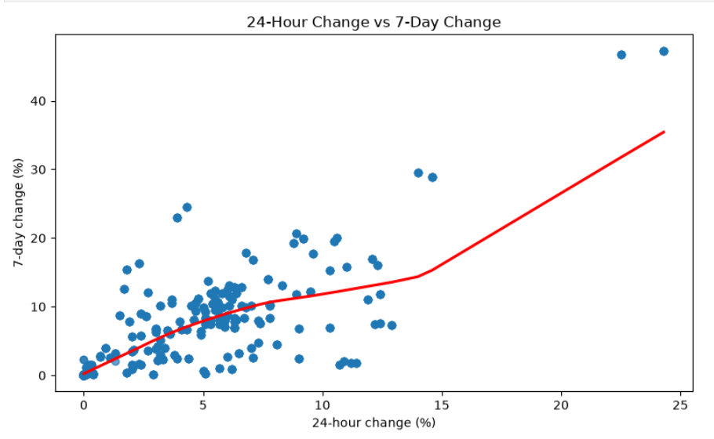
Bivariate analysis
Interpretation :
1. 24-Hour Change vs 7-Day Change
The scatter plot shows a generally positive relationship between 24-hour and 7-day price changes. Cryptocurrencies with higher daily increases often show higher weekly increases, although some exceptions exist. A few extreme values may influence the overall trend.

Slide 14
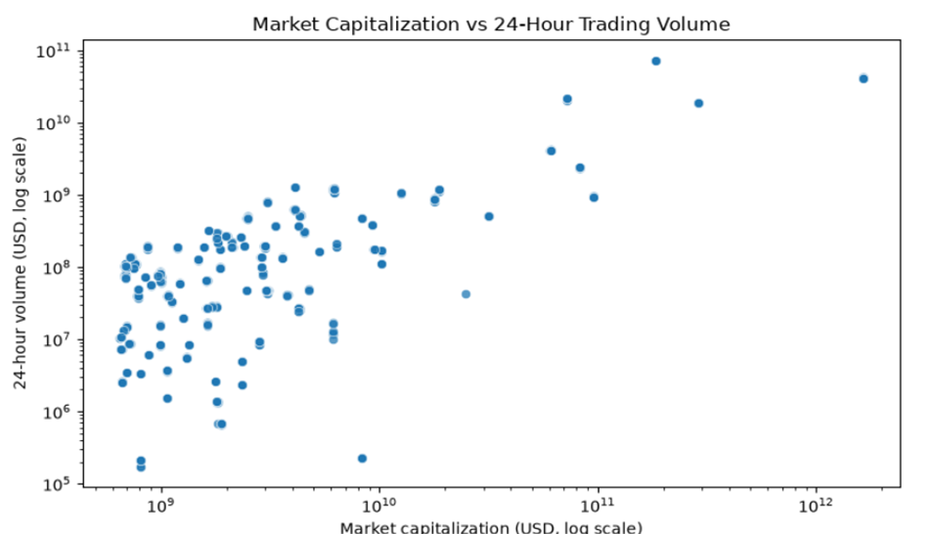
2. Market Capitalization vs 24-Hour Trading Volume
The scatter plot indicates a generally positive relationship between market capitalization and 24-hour trading volume. Cryptocurrencies with higher market capitalization tend to have higher trading volumes, although the relationship varies across assets. Some cryptocurrencies show unusually low or high trading volumes compared with their market value.

Slide 15
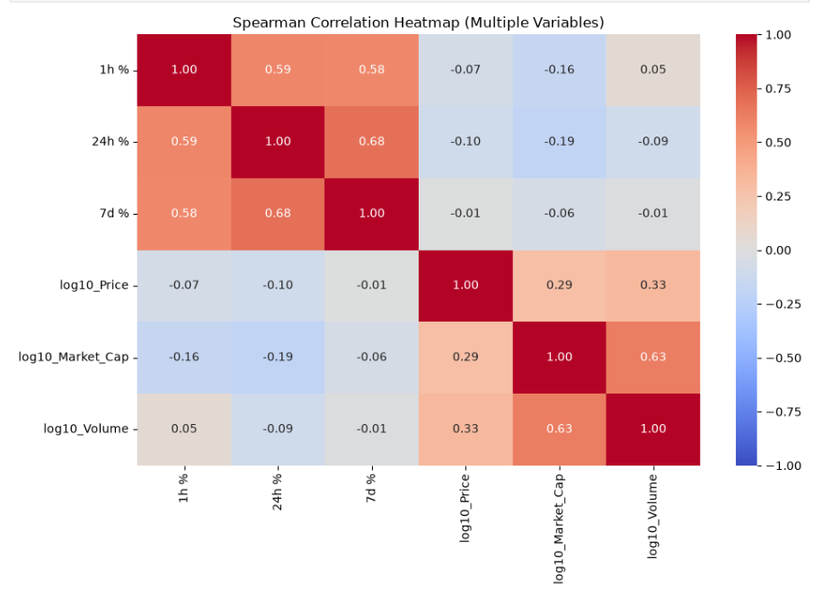
Multivariate analysis

Slide 16
Interpretation :
The Spearman correlation heatmap shows the relationships between multiple cryptocurrency variables. The 24-hour and 7-day percentage changes have a moderately strong positive correlation (0.68). Market capitalization and trading volume also show a positive correlation (0.63), indicating that larger cryptocurrencies generally tend to have higher trading volumes. Price has a weak positive correlation with market capitalization (0.29) and trading volume (0.33). The percentage changes have weak negative or near-zero correlations with price, market capitalization, and volume. Overall, the heatmap highlights the strongest relationships between price-change periods and between market capitalization and trading volume.

Slide 17
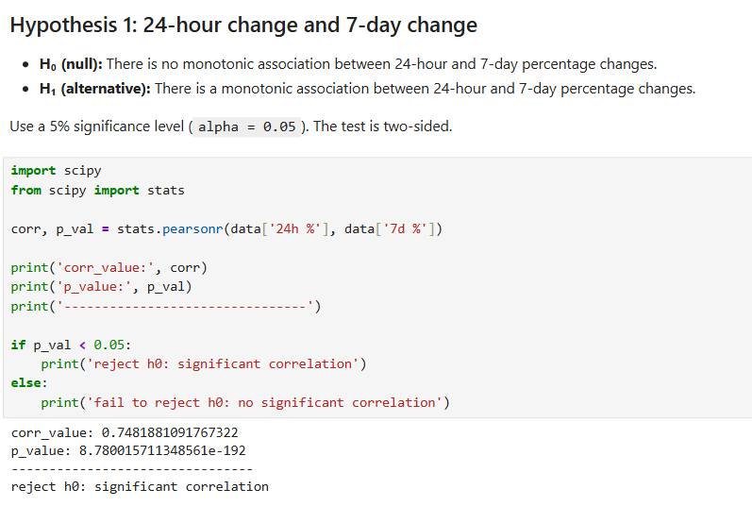
Hypothesis Testing :

Slide 18
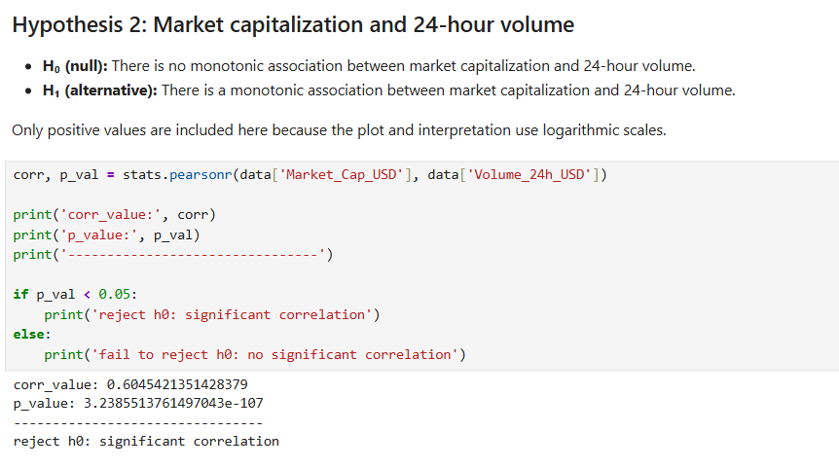

Slide 19
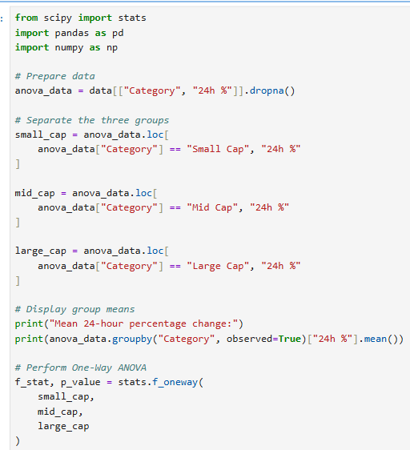
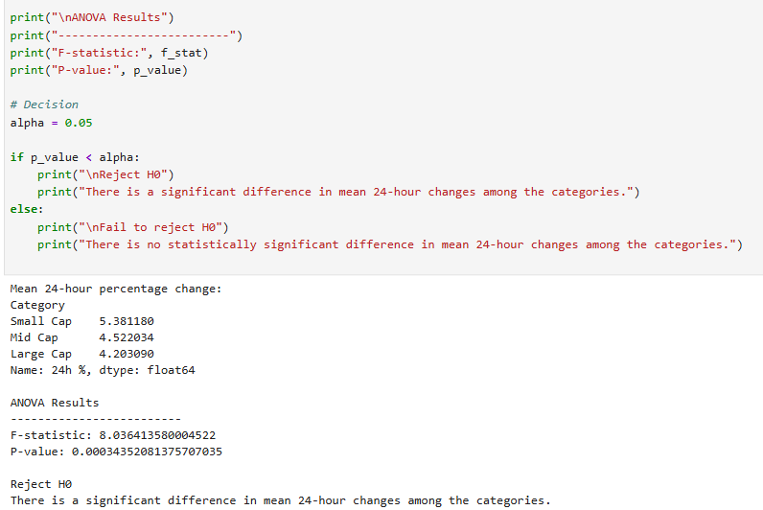
Hypothesis 3:One-Way ANOVA testing¶

Slide 20
Conclusion
Successfully collected cryptocurrency market data from CoinGecko using web scraping.
Cleaned and prepared the dataset for accurate analysis.
Explored cryptocurrency price changes over 1-hour, 24-hour, and 7-day periods.
Identified Bitcoin and Ethereum as the leading cryptocurrencies by market capitalization in the dataset.
Observed a positive relationship between daily and weekly price changes.
Found that market capitalization generally increases with 24-hour trading volume.
Used correlation analysis and visualizations to identify important market patterns.
Gained practical experience in Python, data cleaning, EDA, and statistical analysis.

Slide 21
Recommendations
Monitor Market Trends: Regularly track 1-hour, 24-hour, and 7-day price changes to understand short-term and weekly movements.
Analyze Trading Volume: Compare trading volume with market capitalization to understand cryptocurrency market activity.
Evaluate Market Capitalization: Consider market capitalization when comparing cryptocurrencies of different sizes.
Watch Extreme Price Changes: Investigate unusually high percentage changes, as they may indicate significant market movements.
Use Statistical Analysis: Apply correlation and hypothesis testing to examine relationships between important market variables.
Update Data Regularly: Collect fresh cryptocurrency data to identify changing trends and patterns.

Slide 22

THANK YOU

